Slide 1

Suicide Prevention Analysis
FE 520-A
Team 23
Nishit Rao, Dilpreet Saini and Samruddhi Zemse

Slide 2
TABLE OF CONTENTS
PROBLEM STATEMENT
OBJECTIVES
METHODOLOGY
DATASET
RESULTS
CHALLENGES
RESULTS AND CONCLUSION
RECOMMENDATIONS & FUTURE SCOPE

Slide 3
Problem Statement
Suicide is a highly sensitive and complex phenomenon. Understanding its roots has always been inconsistent throughout the history. Conventional beliefs characterize suicide as a choice of free-willed individuals acting in personal despair.
However, social scientists argue that a large systemic forces stronger than the individuals exist behind the suicides. It is also believed that suicides tend to produce chain-reaction effect, i.e., a greater number of individuals at a given time and in a given geography committing suicides could produce more suicides.
Suicide rates increased a staggering 35% between 2002 and 2022. Suicide is the 5th leading cause of death in the India. The number of people who think about or attempt suicide is even higher. As of October 2022, 12 million Indians adults seriously thought about suicide, 3.5 million planned a suicide attempt and 650K attempted suicide while about 200K died of it.

Slide 4
OBJECTIVES
To work on suicide prevention, we need to have enough information and analyze it to design effective strategies.
Finding out any trends or linkage between factors like gender, age, educational status, or professional profile can help in building strategies.
In this project our agenda was:
To analyze role of age in suicides
To analyze role of gender in suicides
To analyze educational and social background in suicides
To analyze cause and means of suicide
To analyze correlation and derive insights from this exploratory data analysis
The main agenda is to analyze this data to create awareness such that we can prevent this from happening in the future by creating awareness.

Slide 5
DATASET
The dataset consists of data related to suicide cases in India from 2011 to 2022.
It is a combination of multiple datasets.
It is freely available on Kaggle and www.macrotrends.com
This dataset has 237519 rows and 7 columns.
These 7 columns are State, Year, Type Code, Type, Gender, Age Group, Total
State indicates the State of India, Year is the year from 2011-2022, Age Group indicates the age and Gender indicates Male or Female.
Type Code is divided into Causes, Education Status, Means Adopted, Professional Profile and Social Status.

Slide 6
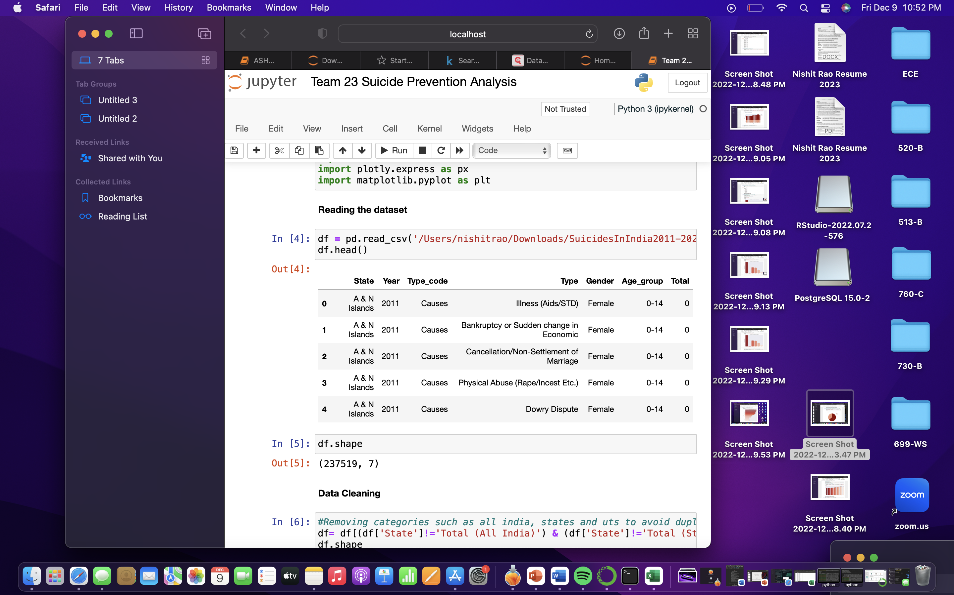
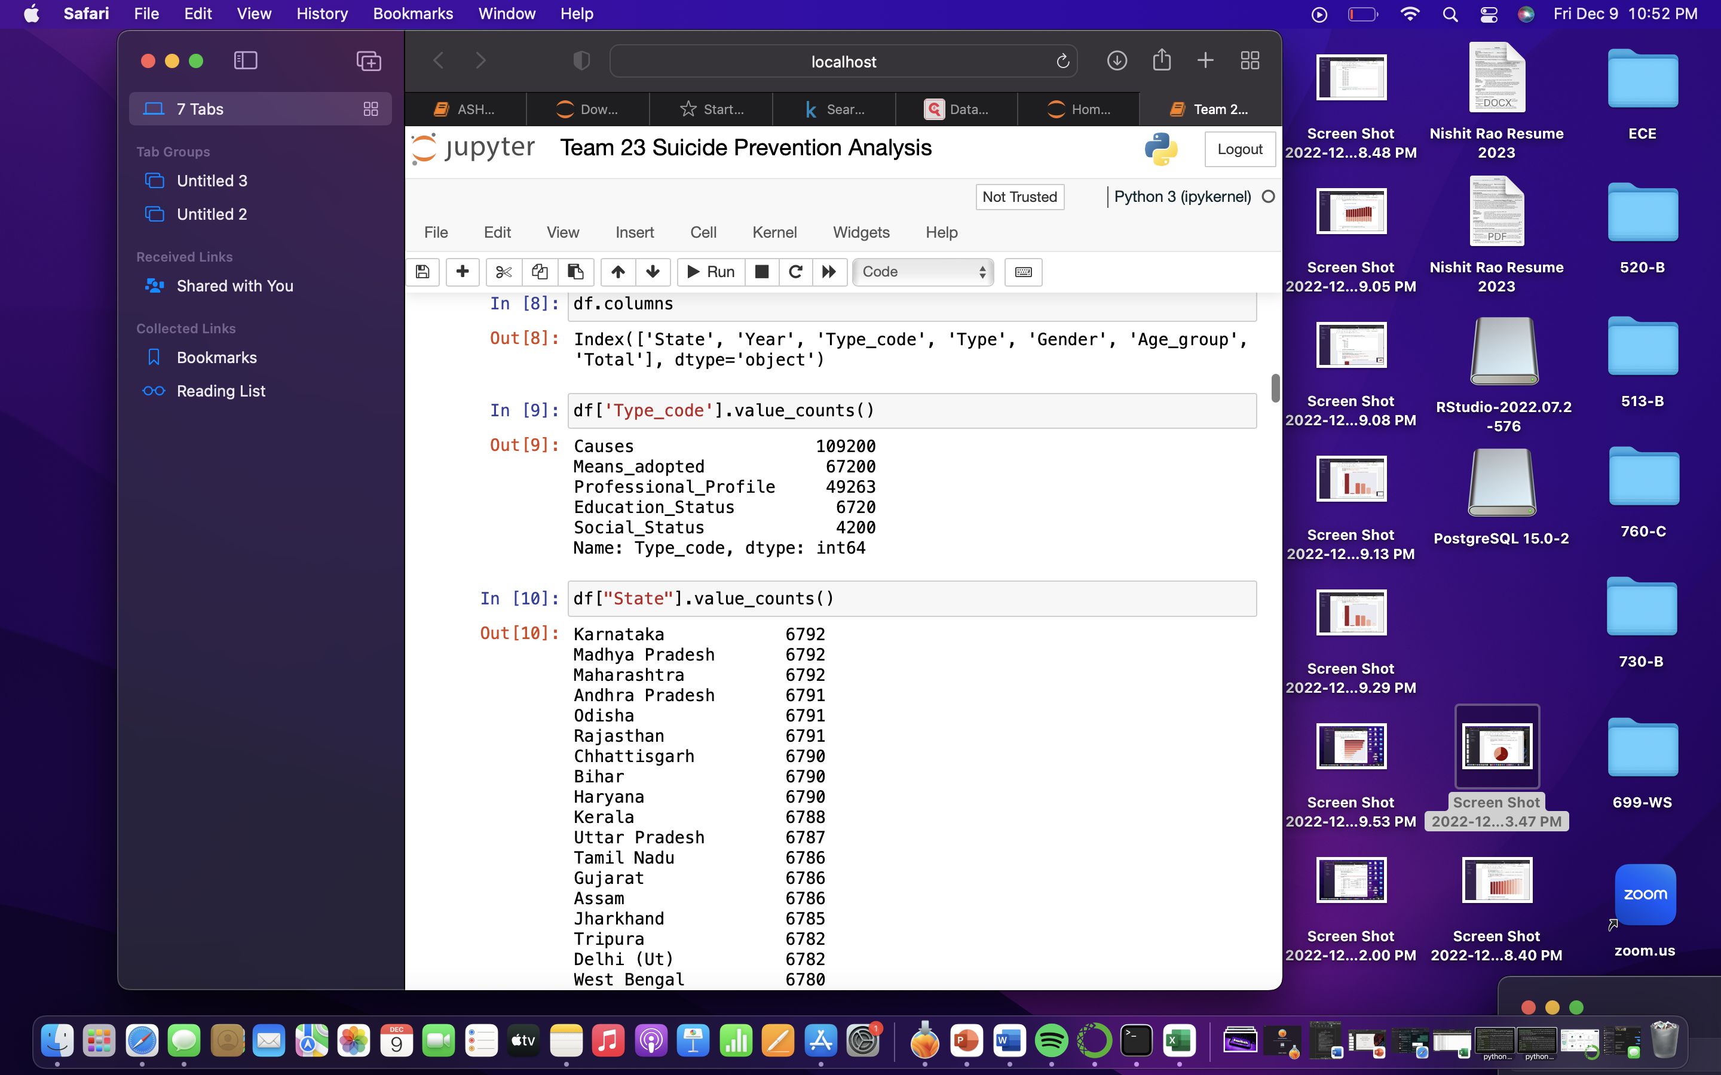
DATASET

Slide 7
METHODOLOGY
We tried to first list all the columns and causes so we knew how many trends we could analyze against each other.
The common denominator for each trend was kept as year, gender, age or state.
We started with reading the dataset, cleaning it, pre-processing it and then went on to do exploratory data analysis.
We found out the numerical data for suicide rate in the past decade based on gender, state, age group, education status, professional profile and social status.
We also found out the major causes of suicide and means adopted to commit it.
We plotted this data using bar plots, cat plots, pie graphs and presented the numerical data in tables.

Slide 8
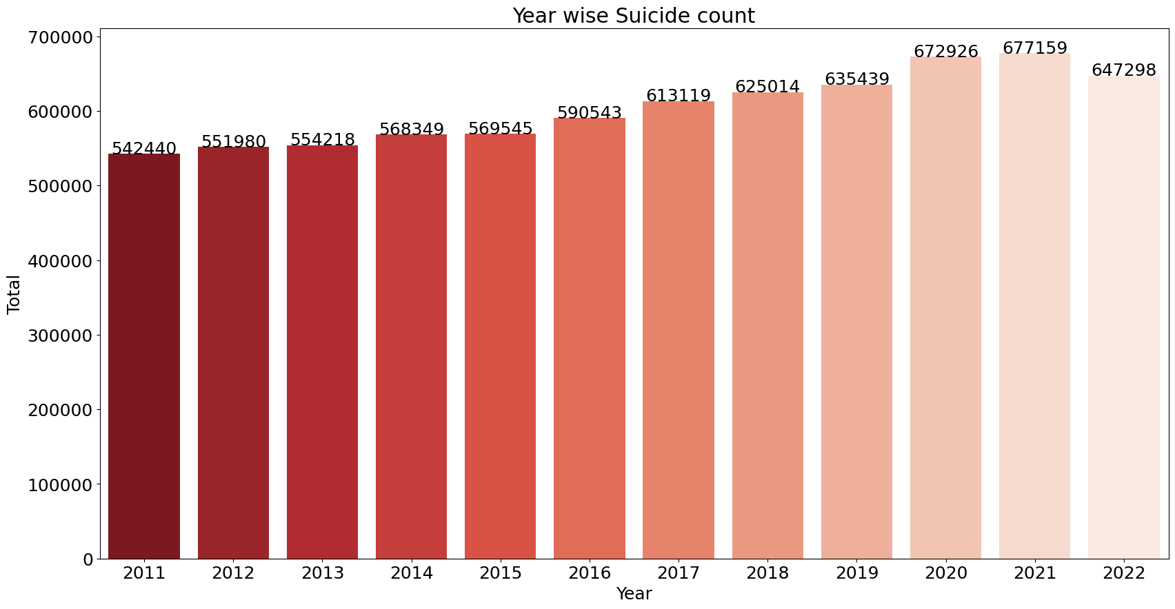
YEARWISE SUICIDE COUNT

Slide 9
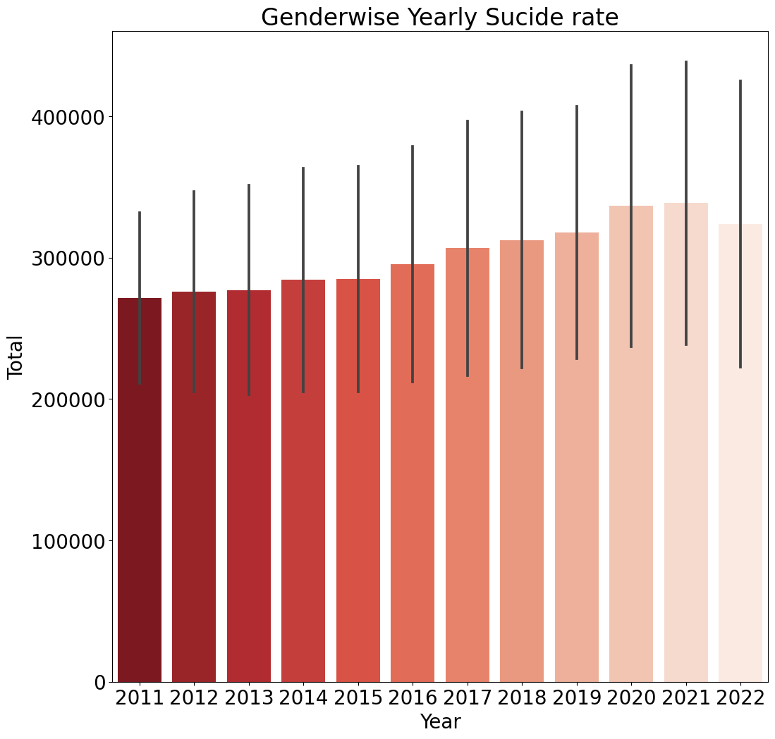
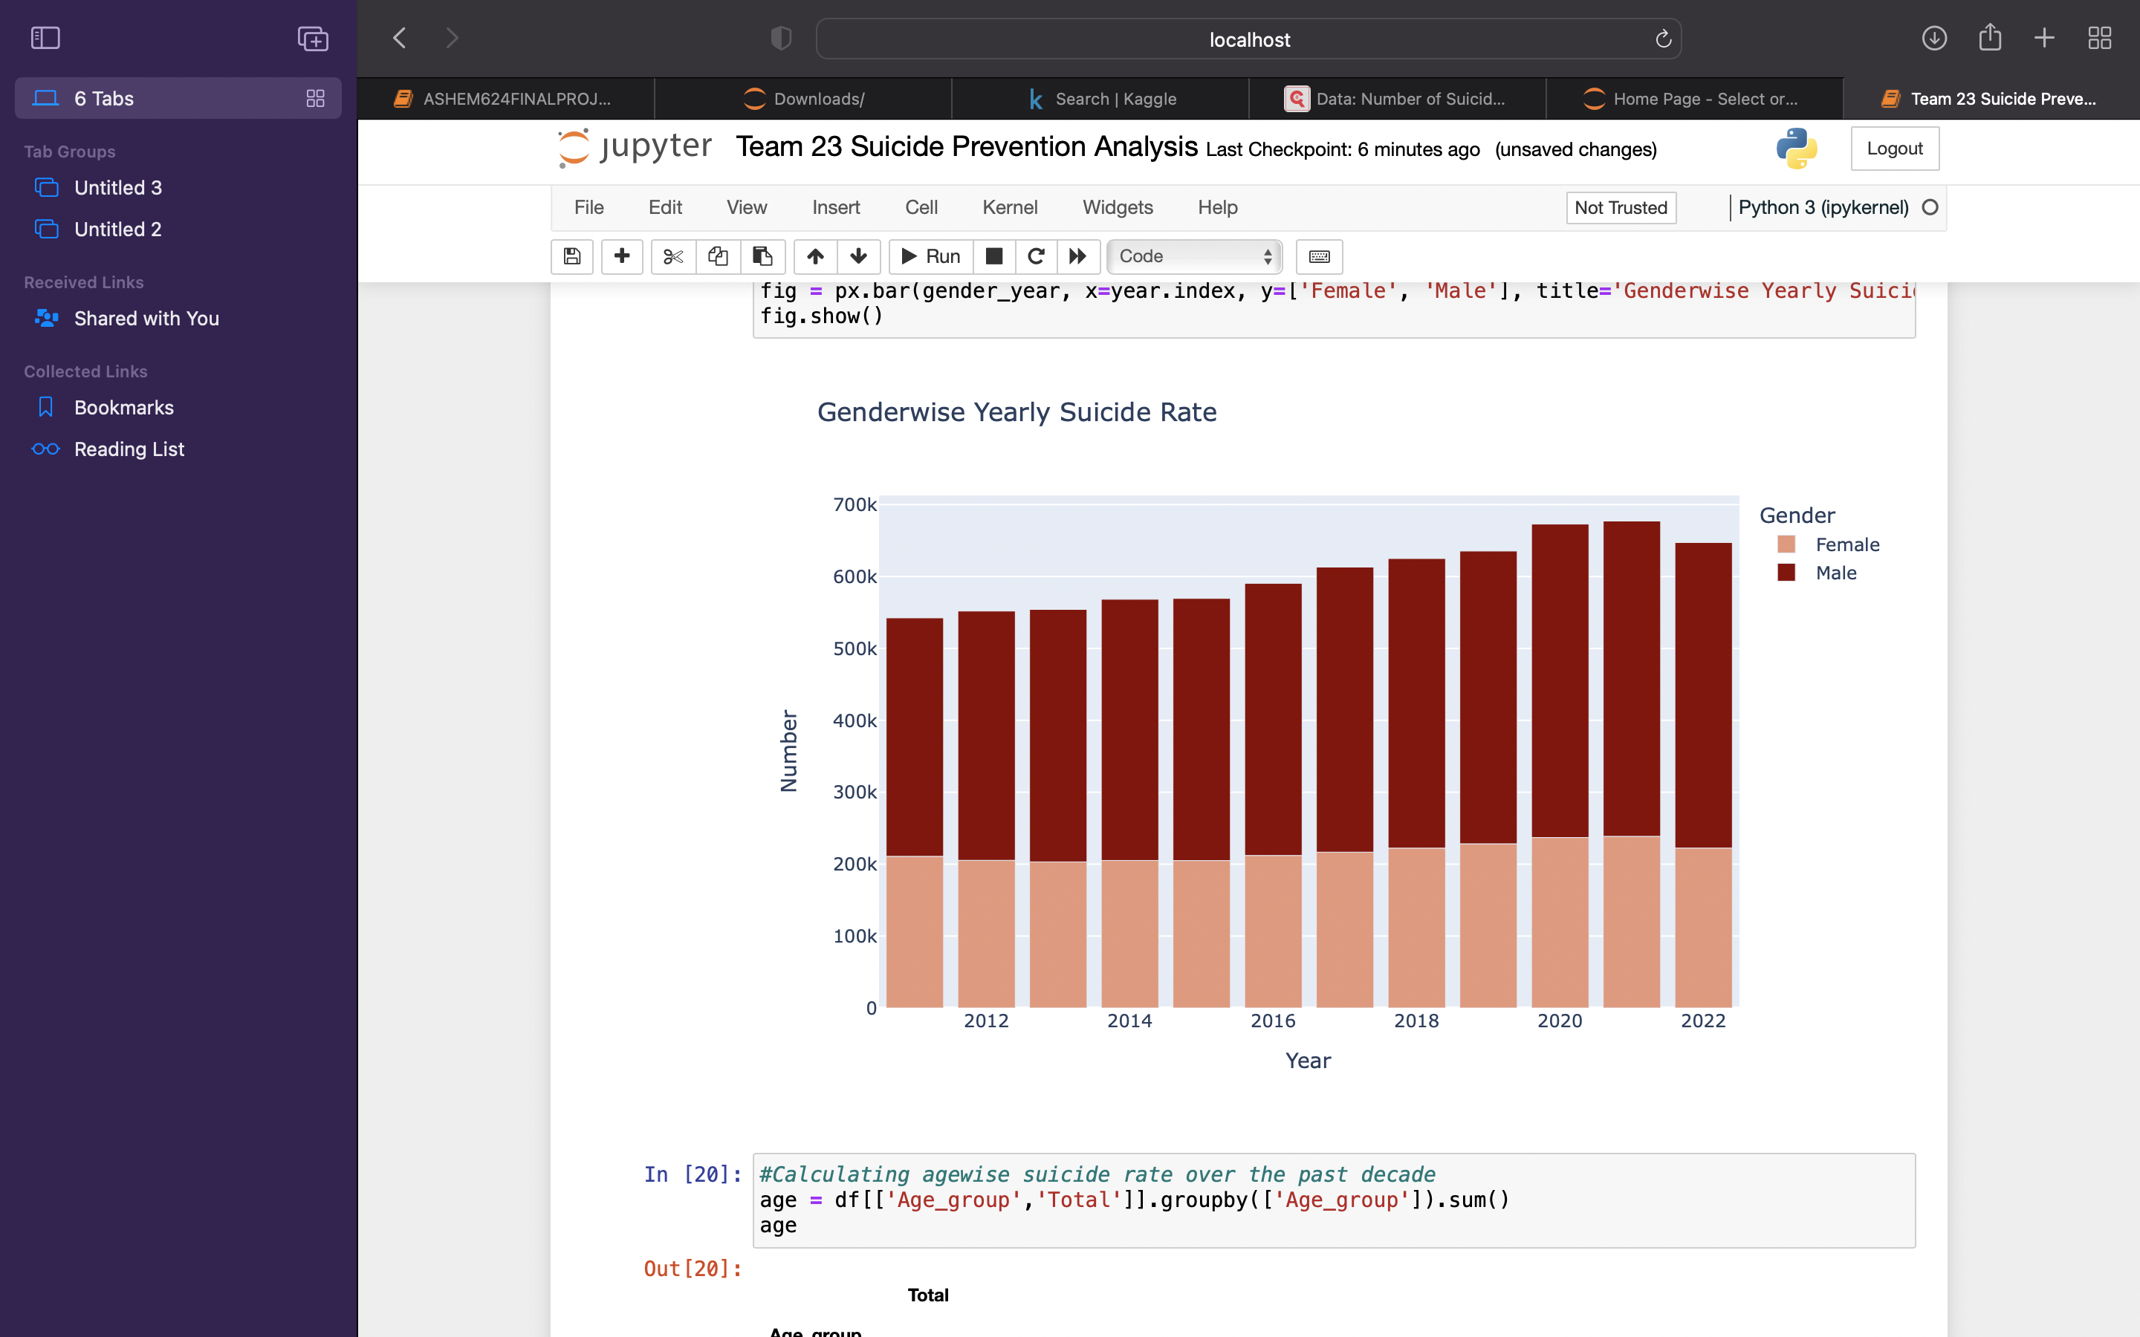
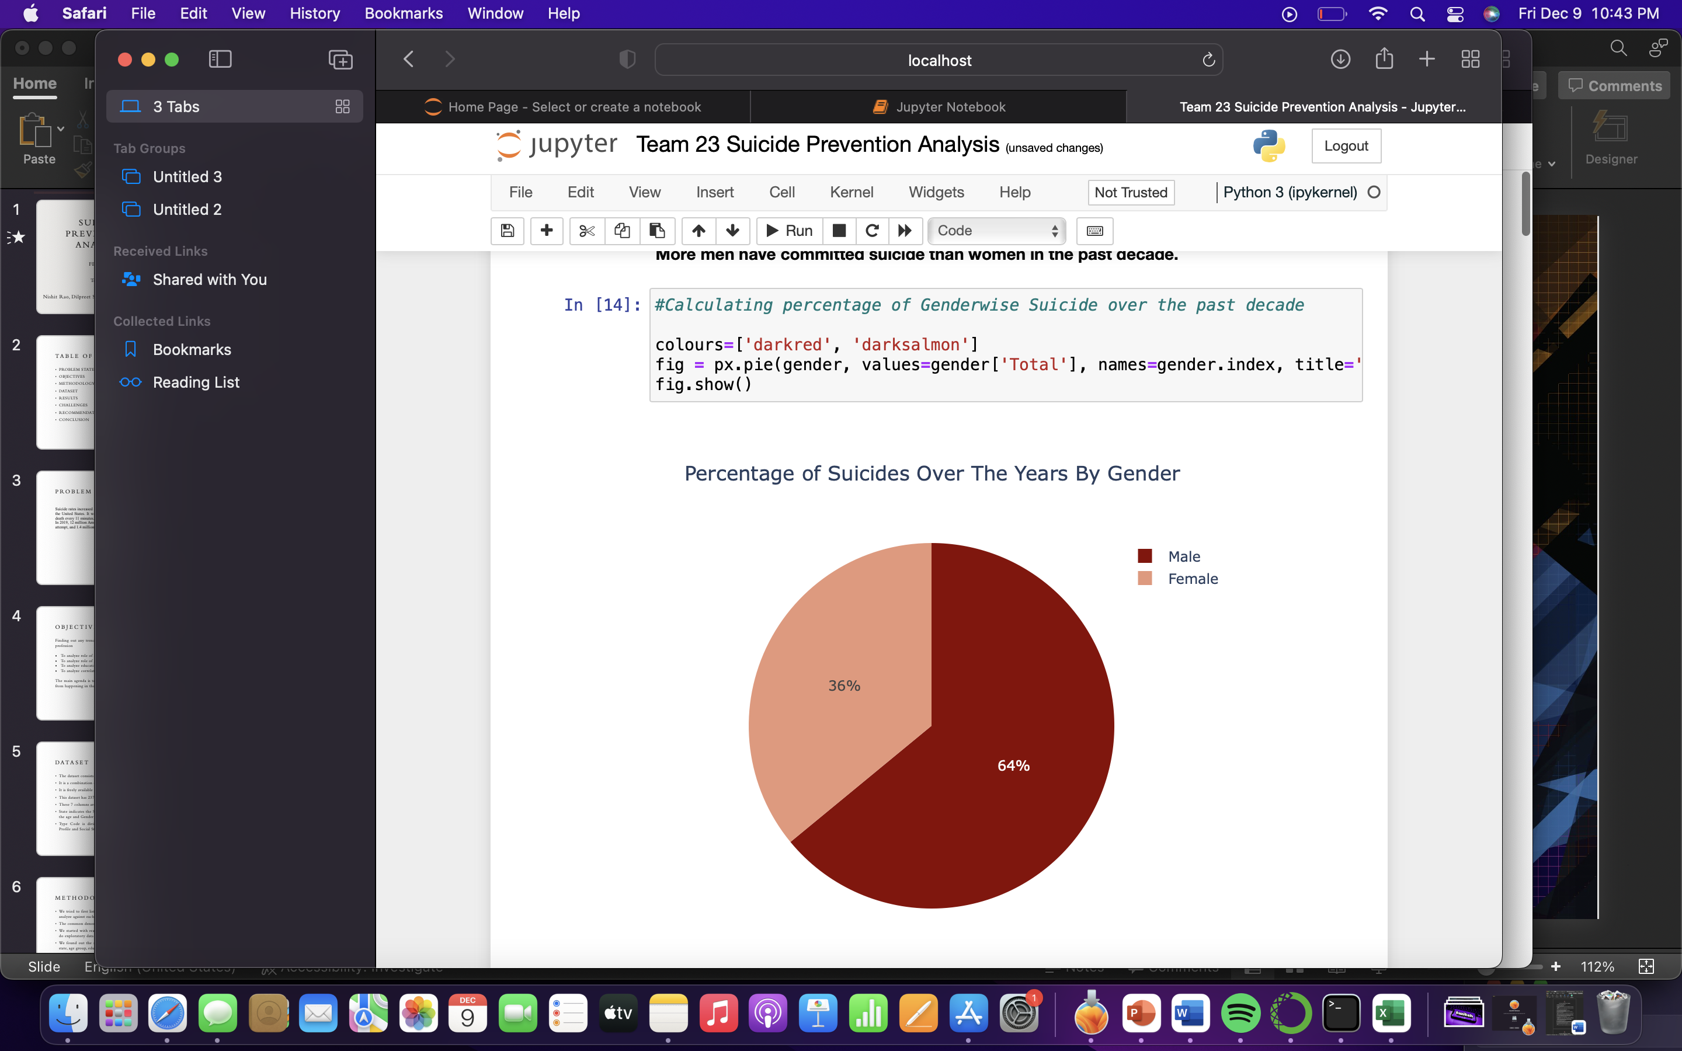
GENDERWISE SUICIDE STATISTICS

Slide 10
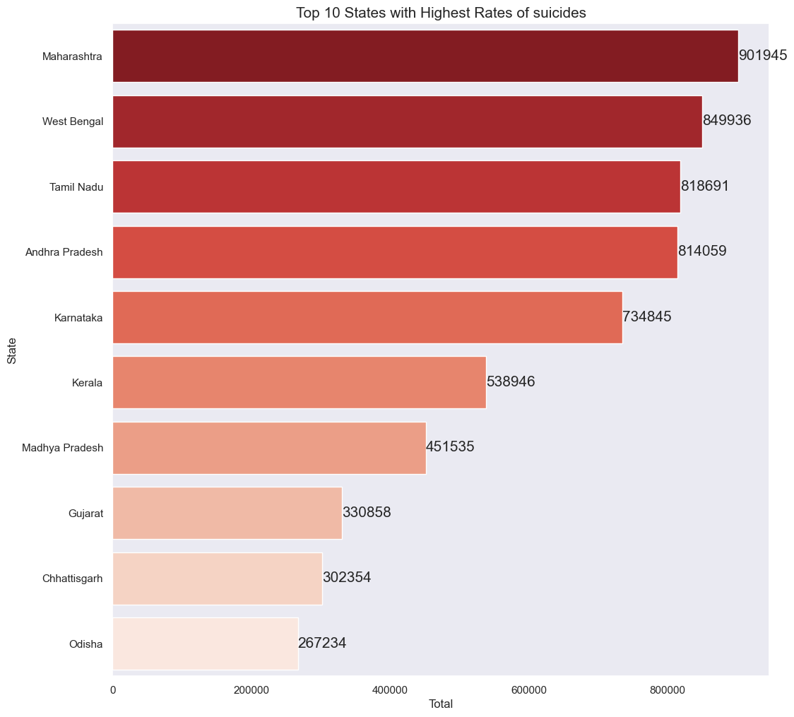
STATE WITH HIGHEST SUICIDE RATE

Slide 11
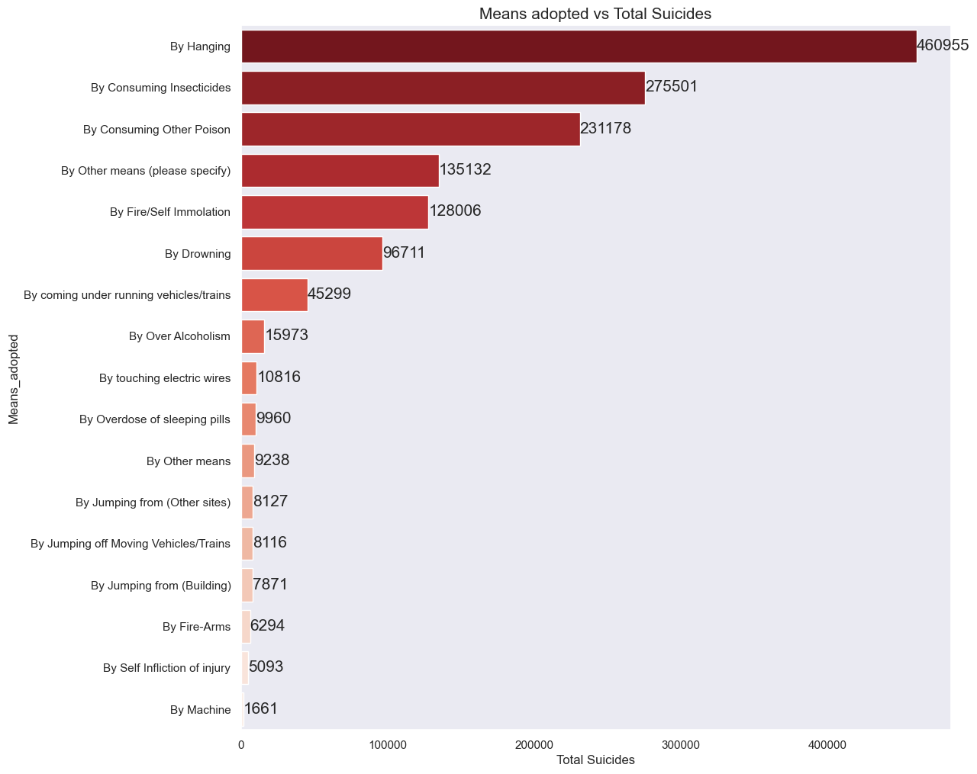
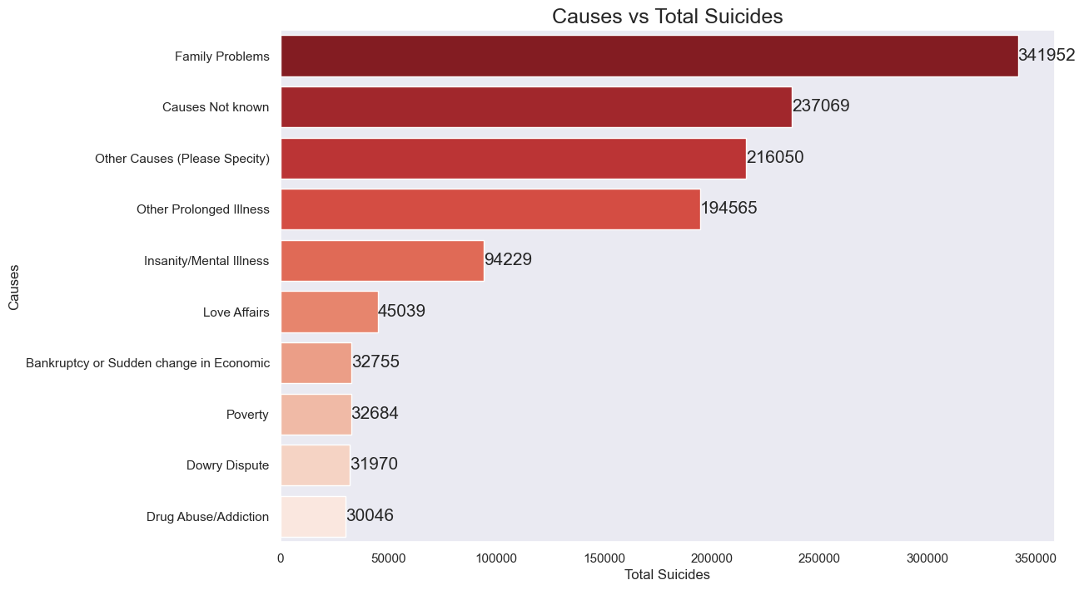
Cause and Means

Slide 12
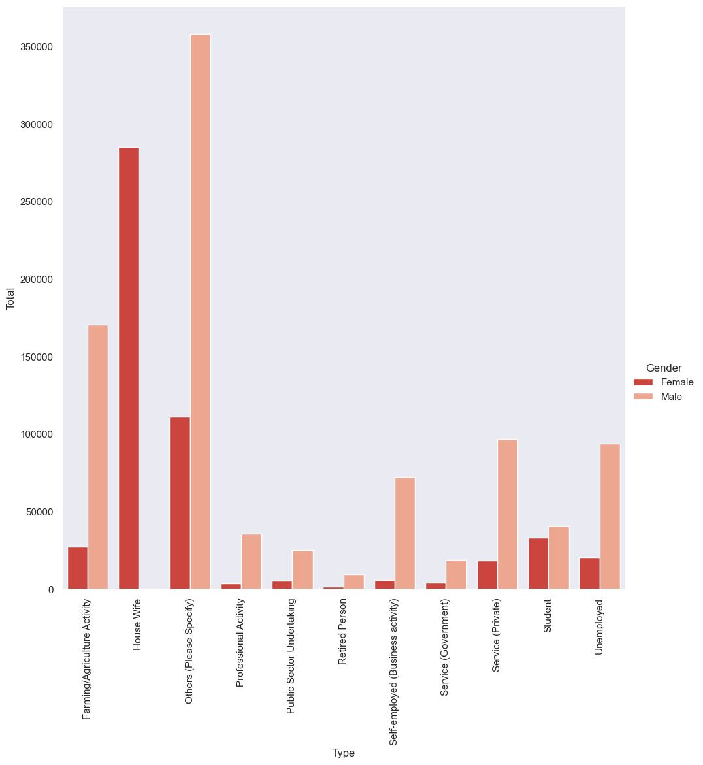
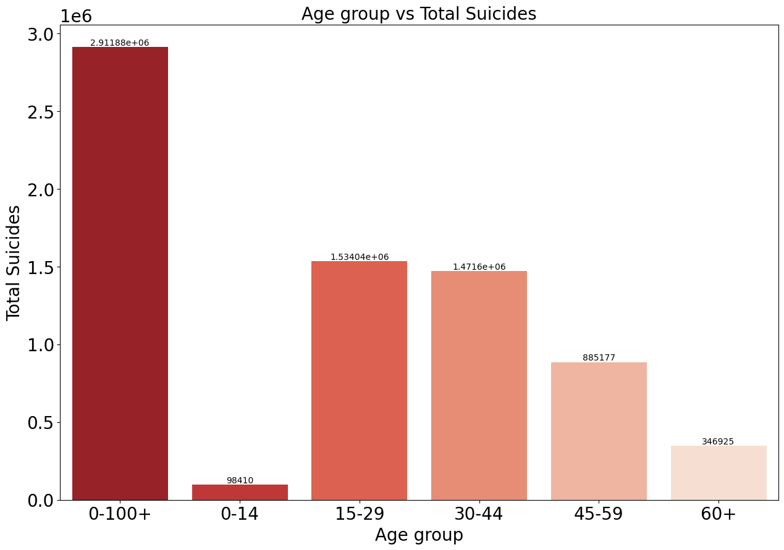
Age & Professional Profile

Slide 13
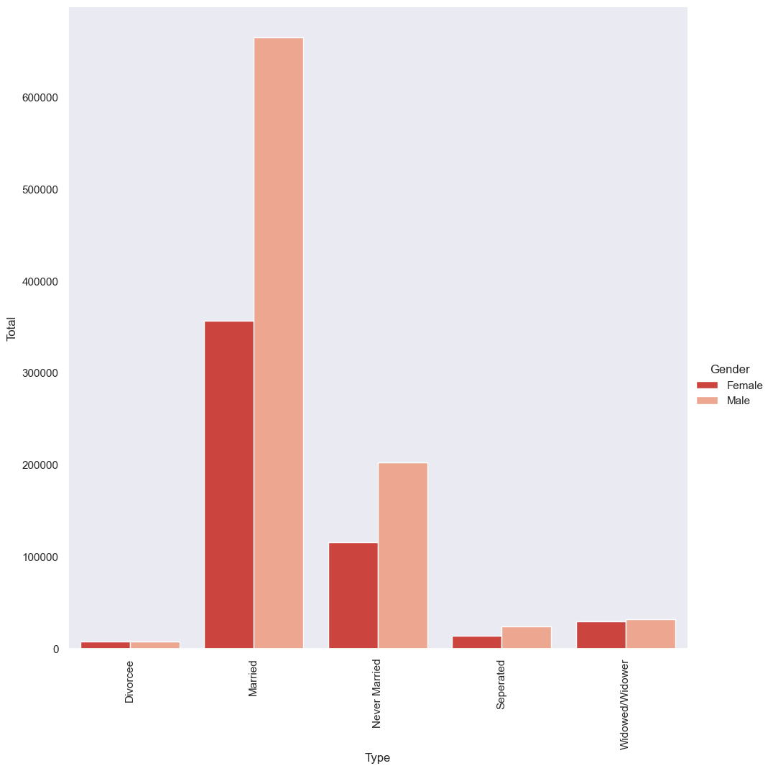
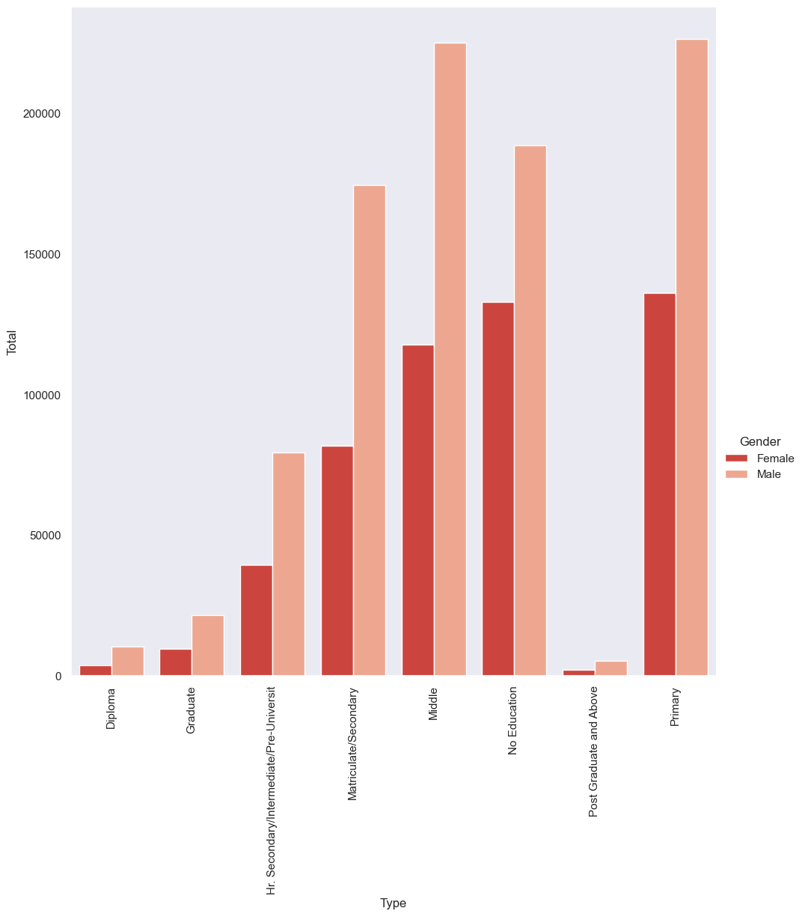
Social status & Education status

Slide 14
RESULTS & CONCLUSION
There is an upward trend in suicides all over the country from 2011-2022.
More men have committed suicide than women in the past decade.
Ages 15-29 are most susceptible to suicide as they are young and very impressionable.
Maharashtra is the state with most suicides in the past decade followed by West Bengal and Tamil Nadu. These are also some of the states with the highest literacy rate.
Highest number of suicides were committed due to family problems, followed by unknown causes, prolonged illness and mental illness.
More men than women committed suicide due to family problems.
Men with Primary and Middle School education were most prone to suicide while women with Primary or no education were most prone to suicide
Housewives and Farmers were the professions that committed the highest number of suicides
Hanging was the most common means of suicide with 460955 cases followed by consuming insecticide or poison.
Married women followed by married men were most susceptible to suicide.

Slide 15
CHALLENGES
The dataset had a lot of redundant data which needed to be cleaned to give clean visualization.
There wasn’t enough time to analyze the entire dataset as there are plenty of trends that can be analyzed by pitting one factor against the other and keeping the denominators as common.
Most datasets did not have explicit data hence we had to combine multiple datasets and some states and causes that were on low priority were left out in the process

Slide 16
RECOMMENDATION & FUTURE SCOPE
In the future we can analyze using machine learning algorithms and classifiers to better understand the data set and build a model that can state probable causes based on history of a particular state.
We can tie up with mental health organizations to provide analysis on this dataset and help them narrow down their targeted audience
More awareness can be spread using a bigger dataset or a more area specific dataset and further exploratory analysis.

